Slide 1
Human–AI Teaming Approach to Infectious Disease Modeling
SISMID 2026
INSTRUCTORS
Lior Rennert, PhD
Nathan McNeese, PhD
Amanda Bleichrodt, PhD

Slide 2



Introductions
Dr. Lior Rennert, PhD
Dr. Nathan McNeese, PhD
Dr. Amanda Bleichrodt, PhD
Instructor
Instructor
Instructor

Slide 3
Course Outline
A three-day, hands-on path from forecasting foundations to AI-refined models.
DAY 1
Foundations & Setup
DAY 2
Prompting & Forecasting
DAY 3
Evaluation & Refinement
Overview of forecasting
Intro to AI & human–AI teaming
GitHub & VS Code setup
Data cleaning (Lab 1) + GitHub Commits
AI prompting strategies
Working with rules.md files
Data visualization (Lab 2)
Building the forecasting pipeline
Forecasting (Lab 3)
Overview of model evaluation
Model evaluation (Lab 4)
AI/HAT evaluation
Working with AI for refinement
Model refinement (Lab 5)
Questions & free coding

Slide 4
Goals of the Course
What it is, and isn't
Expectations with AI
How we'll work
Get comfortable with AI-supported modeling and Human–AI Teaming (HAT)
Infectious disease forecasting is our case study, not the end goal
Focus is critical thinking and best practices, not definitive implementation guidelines
AI isn’t perfect, and there’s no single “right” approach
A human expert is essential for validation, how do we know the output is correct?
AI will keep improving; the aim is experience you can adapt to your own work
Practical note: managing tokens (and what to do if you run out)
Most of our time will be spent in hands-on labs, where we will show you multiple ways of doing things
Mix of class-led walkthroughs, guided solo exercises, and free-flow coding
Don’t be discouraged if something breaks or is unclear, you can always ask
HAT-based approach for this course: Instructors will create structure for AI-based implementation, class will help refine approach through collaboration with each other, instructors and AI

Slide 5


Life Secret: Instructors don’t know everything

Slide 6
Infectious Disease Forecasting
July 22, 2026

Slide 7
Infectious Disease Forecasting: Outline
Concepts & Methods
Background
Model components
Model types: ARIMA, GAM, XGBoost, ensemble
Incorporating predictors
Training & testing periods
Model evaluation
Model refinement
Use Case: Influenza Forecasting
CDC NHSN inpatient admissions
Data visualization
Model building
Training & testing
Evaluation
Refinement
FluSight submission

Slide 8
Background
Infectious disease forecasting is a data-driven field that uses mathematical, statistical, and AI models to predict the trajectory, timing, and severity of disease outbreaks.
Like weather forecasting, it gives decision-makers a probabilistic look ahead.
Informs decisions: situational awareness, planning, real-time response and resource allocation, and policy.
Widely used in practice: efforts like CDC FluSight, COVID-19 and RSV Forecast Hubs combine many models to guide national response.
Also used by hospitals and healthcare entities for surge planning and response
Inherently challenging: data are noisy, delayed, and revised; human behavior shifts; novel pathogens offer little historical signal; and existing pathogens often lack real-time leading indicators

Slide 9
Components of Infectious Disease Models
In this course, we focus on statistical and machine learning models. Their typical components include:
Forecast target
Input data
Model form
What we predict: cases, hospitalizations, deaths, peak timing, or epidemic size.
Surveillance signals: E.g., cases, test positivity, digital traces, admissions, waste-water, vaccination, or mobility.
The math linking inputs to the target: e.g., regression model
Observation process
Uncertainty estimates
Forecast horizon
Adjusts for imperfect data: underreporting, delays, noise, and revisions.
Prediction intervals or probabilistic forecasts: a range of plausible futures.
How far ahead we predict, e.g., 1 to 4 weeks; accuracy drops further out.

Slide 10
Building a Forecast

Slide 11

Legend
Target Data
Auxiliary Data
Model Estimates
Model Projections
Current Week
The week the forecast was conducted. It separates the model estimates from the projection period.

Slide 12
Target Data
The historical data the model learns from and uses to estimate its parameters; it represents the outcome being forecasted by the model.
Example: In-patient hospitalizations
Legend
Target Data

Slide 13
Auxiliary Data
Additional datasets incorporated as predictors or supporting variables in the model to enhance its predictive accuracy.
Example: Wastewater RNA concentration
Legend
Target Data
Auxiliary Data

Slide 14
Legend
Target Data
Auxiliary Data
Model Estimates
Model Estimates
Historical model outputs for periods with observed data.

Slide 15
Training Period
The span of time during which a model learns from historical data. During this period, the model identifies patterns in the data and adjusts its internal parameters.

Slide 16
Testing Period
The time when a model’s performance is evaluated on new, unseen data.

Slide 17
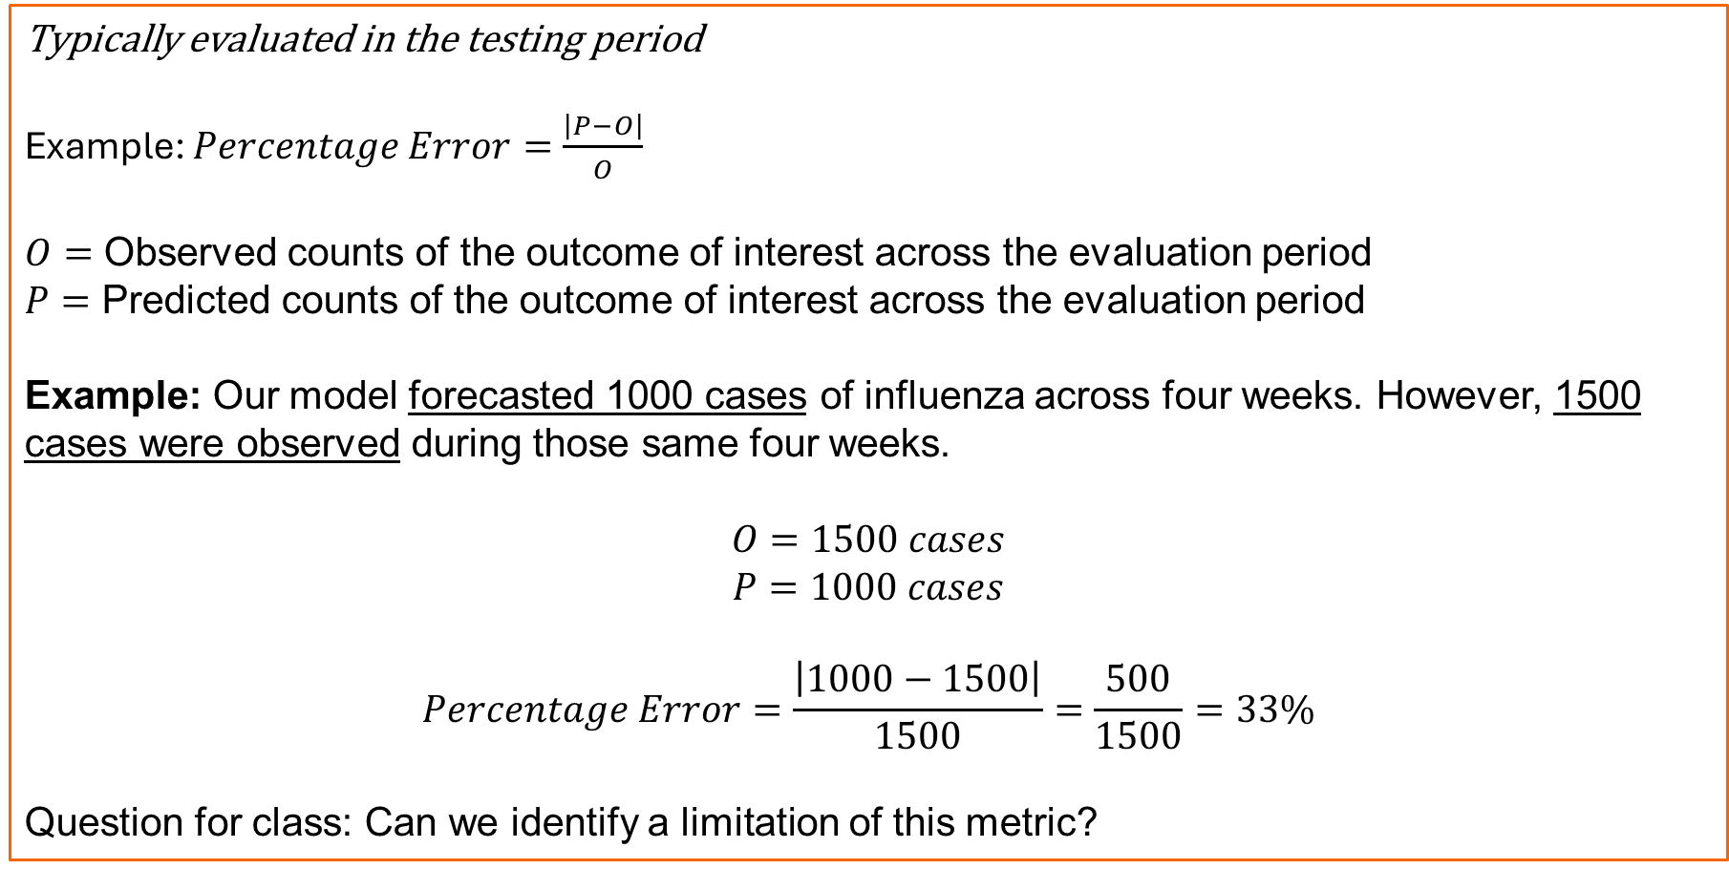
Evaluation Example: Error
Typically evaluated in the testing period
Example: $Percentage Error=\frac{\left|P−O\right|}{O}$
$O=$ Observed counts of the outcome of interest across the evaluation period
$P=$ Predicted counts of the outcome of interest across the evaluation period
Example: Our model forecasted 1000 cases of influenza across four weeks. However, 1500 cases were observed during those same four weeks.
$$O=1500 cases$$
$$P=1000 cases$$
$$Percentage Error=\frac{\left|1000−1500\right|}{1500}=\frac{500}{1500}=33\%$$
Question for class: Can we identify a limitation of this metric?

Slide 18
Legend
Target Data
Auxiliary Data
Model Estimates
Model Projections
Model Projections
Model-generated values for future periods without observed data.

Slide 19
Projections Terminology: Horizons
Forecasting Horizon (h): The number of future time points (e.g., weeks, days) from the “current” reference point for which a forecast provides predictions. It defines how far into the future the model is attempting to project the outcome of interest.
h = 2
h = 0
h = 3
h = 1

Slide 20
Projections Terminology
Nowcast
A “right-now” prediction that provides a real-time (or near real-time) picture of the current trajectory of the outcome of interest.
h = 0
h = 2
h = 3
h = 1

Slide 21
Projections Terminology
Forecast
A prediction that provides a view of the future trajectory of the outcome of interest.
h = 0
h = 2
h = 3
h = 1

Slide 22
Infectious Disease Models

Slide 23
Overview
Infectious disease models span a spectrum, from statistical methods to machine learning and other combined-model approaches.
ARIMA - Primary
GAM
XGBoost
Ensemble
Models a series from its own past — autocorrelation, trend (via differencing), and seasonality.
Flexible regression using smooth spline terms to capture nonlinear trends and seasonality.
Gradient-boosted decision trees that learn from engineered features and lagged predictors.
Combines several models’ forecasts (mean, median, or weighted) — usually the most robust.
Statistical methods
Machine learning & AI
Combined Approach

Slide 24
Example Model Overview(s)
ARIMA — Statistical
Models a series from its own past — autocorrelation, trend (via differencing), and seasonality.

Slide 25
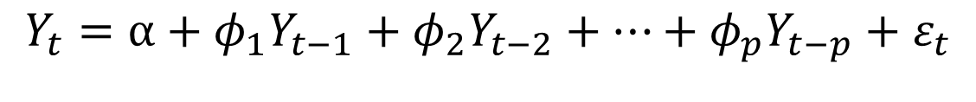
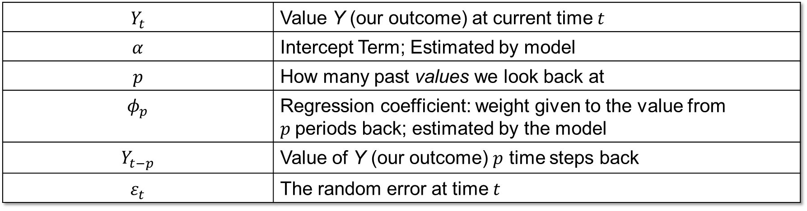
AutoRegressive Model
At its core, an AR model is just linear regression that uses the series' own recent values to predict what comes next.
$$Y_{t}=α+φ_{1}Y_{t−1}+φ_{2}Y_{t−2}+…+φ_{p}Y_{t−p}+ε_{t}$$
$$Y_{t}$$ | Value Y (our outcome) at current time $t$
$$α$$ | Intercept Term; Estimated by model
$$p$$ | How many past values we look back at
$$φ_{p}$$ | Regression coefficient: weight given to the value from $p$periods back; estimated by the model
$$Y_{t−p}$$ | Value of Y (our outcome) $p$ time steps back
$$ε_{t}$$ | The random error at time $t$

Slide 26
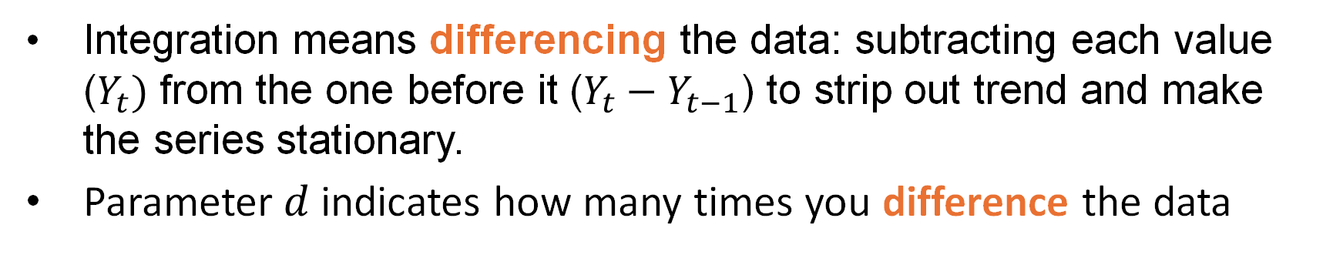
Integrated Model
ARIMA requires the time series to be made stationary
What is a stationary time series?
A time series is stationary if its statistical behavior doesn't change over time (e.g., constant mean, variance)
Integration means differencing the data: subtracting each value ($Y_{t})$ from the one before it ($Y_{t}−Y_{t−1}$) to strip out trend and make the series stationary.
Parameter $d$indicates how many times you difference the data

Slide 27
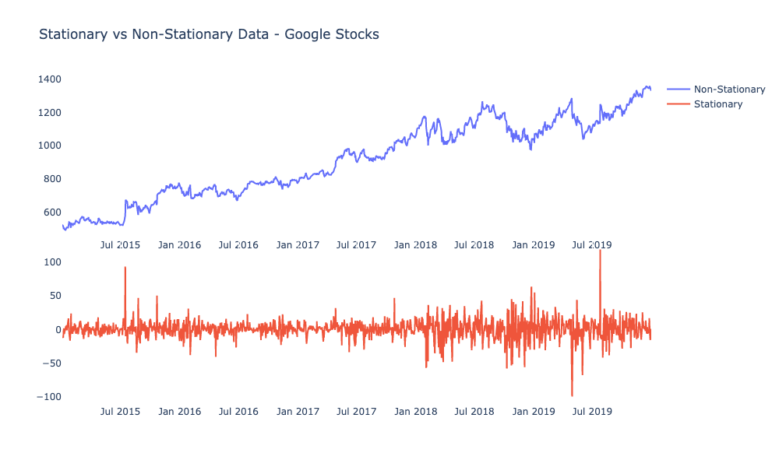
Example: Stationary Time series
Wise, Time Series…, 2020
Notes:
https://blogs.cisco.com/analytics-automation/arima2

Slide 28
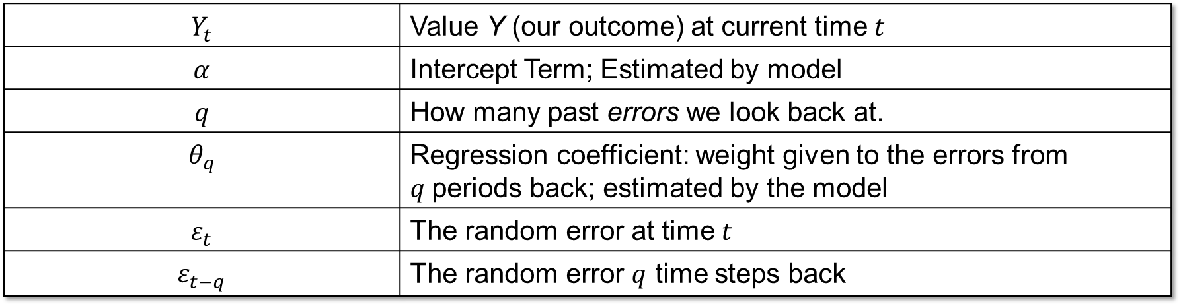
Moving Average Models
In an MA model, the current value is a linear combination of recent (current and past) random errors ("white noise").
$$Y_{t}=α+ε_{t}+θ_{1}ε_{t−1}+θ_{2}ε_{t−2}+…+θ_{q}ε_{t−q}$$
$$Y_{t}$$ | Value Y (our outcome) at current time $t$
$$α$$ | Intercept Term; Estimated by model
$$q$$ | How many past errors we look back at.
$$θ_{q}$$ | Regression coefficient: weight given to the errors from $q$periods back; estimated by the model
$$ε_{t}$$ | The random error at time $t$
$$ε_{t−q}$$ | The random error $q$ time steps back

Slide 29
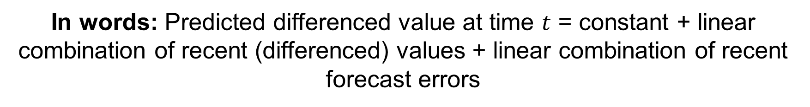
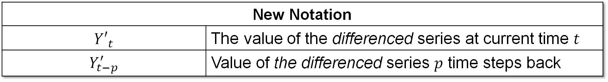
ARIMA Models
ARIMA: Autoregressive Integrated Moving Average
All three components combine to create an ARIMA model (AR + I + MA).
$Y_{t}′=α+φ_{1}Y_{t−1}^{′}+…+φ_{p}Y_{t−p}^{′}+ε_{t}$ $+θ_{1}ε_{t−1}+…+θ_{q}ε_{t−q}$
New Notation
$${Y′}_{t}$$ | The value of the differenced series at current time $t$
$$Y_{t−p}^{′}$$ | Value of the differenced series $p$ time steps back
In words: Predicted differenced value at time $t$ = constant + linear combination of recent (differenced) values + linear combination of recent forecast errors

Slide 30
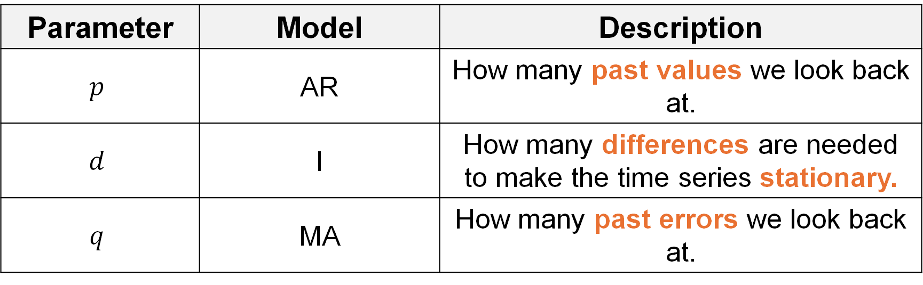
Parameters {p, d, q}
Parameter | Model | Description
$$p$$ | AR | How many past values we look back at.
$$d$$ | I | How many differences are needed to make the time series stationary.
$$q$$ | MA | How many past errors we look back at.
We will be using the auto.arima() function from the forecast package. Therefore, the parameter values will automatically be selected via the Hyndman-Khandakar Algorithm.

Slide 31
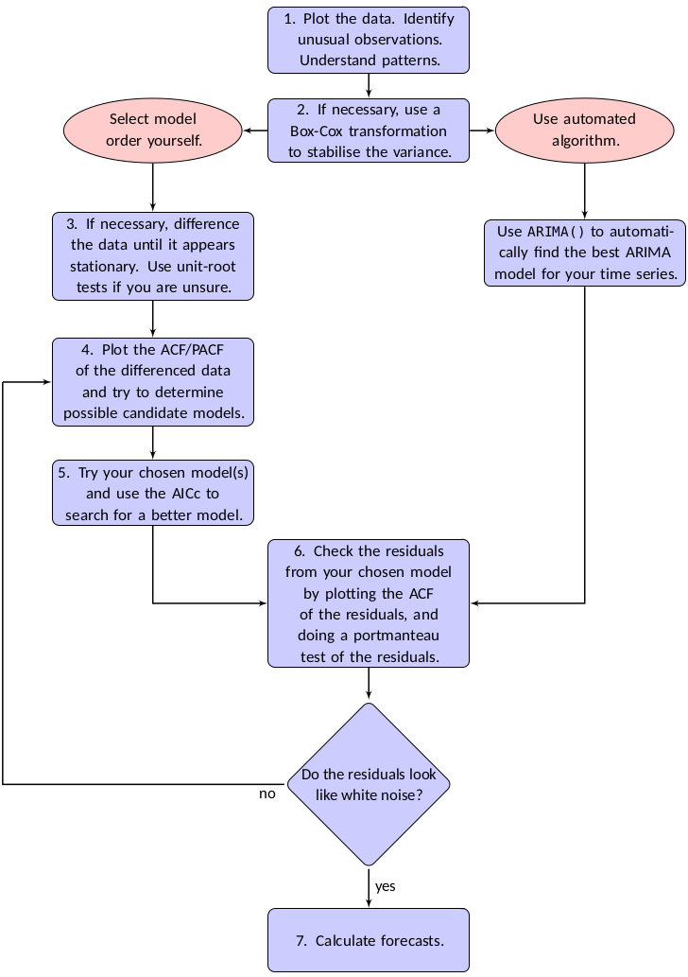
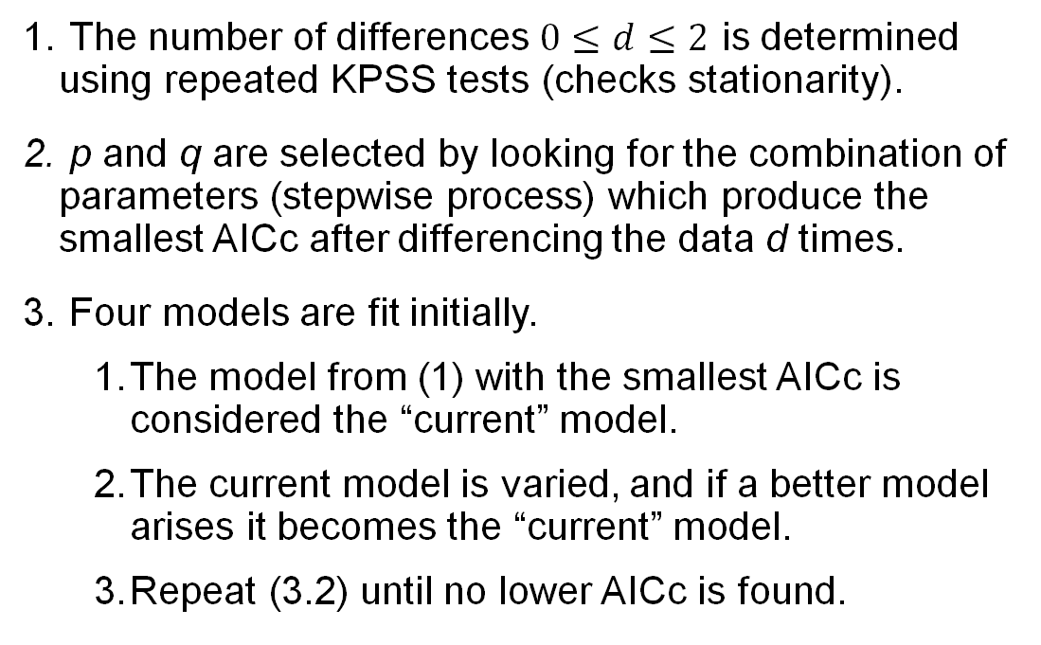
Hyndman-Khandakar Algorithm
The number of differences $0≤d≤2$ is determined using repeated KPSS tests (checks stationarity).
p and q are selected by looking for the combination of parameters (stepwise process) which produce the smallest AICc after differencing the data d times.
Four models are fit initially.
The model from (1) with the smallest AICc is considered the “current” model.
The current model is varied, and if a better model arises it becomes the “current” model.
Repeat (3.2) until no lower AICc is found.
Hyndman & Athanasopoulos, Forecasting…, 2026

Slide 32
Example Model Overview(s)
ARIMA — Statistical
GAM — Statistical
Models a series from its own past — autocorrelation, trend (via differencing), and seasonality.
Flexible regression using smooth spline terms to capture nonlinear trends and seasonality.

Slide 33
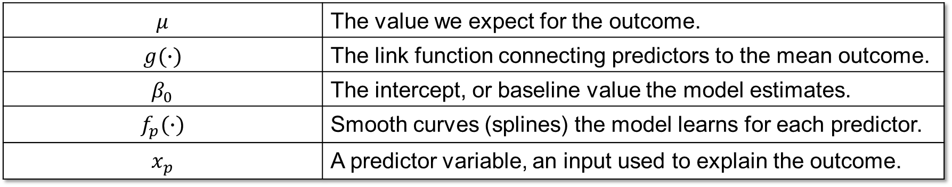
Generalized Additive Models
Very similar to Generalized Linear Models (GLM) but allows for modeling of more complex data trends (i.e., non-linear data) via “smoothing” functions (splines, we will cover these shortly).
$$g\left(μ\right)=β_{0}+f_{1}\left(x_{1}\right)+f_{2}\left(x_{2}\right)+…+f_{p}\left(x_{p}\right)$$
$$μ$$ | The value we expect for the outcome.
$$g(∙)$$ | The link function connecting predictors to the mean outcome.
$$β_{0}$$ | The intercept, or baseline value the model estimates.
$$f_{p}(∙)$$ | Smooth curves (splines) the model learns for each predictor.
$$x_{p}$$ | A predictor variable, an input used to explain the outcome.

Slide 34
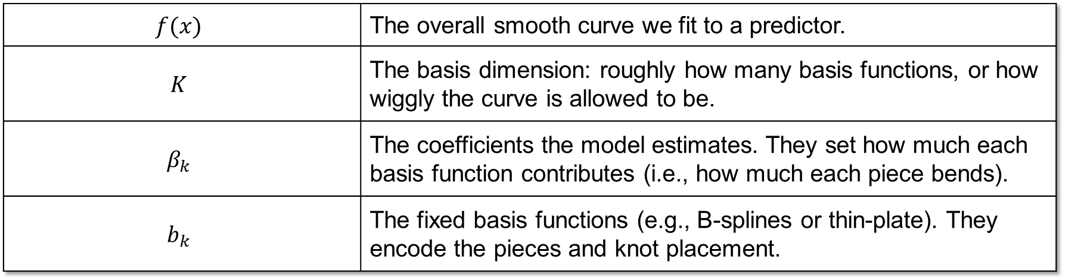

What are splines?
Smooth, flexible curves made by joining simple polynomial pieces (usually cubics) at points called knots, so it can bend to fit data without kinks.
$$f(x)=\sum_{k=1}^{K}{β_{k}b_{k}(x)}$$
$$f(x)$$ | The overall smooth curve we fit to a predictor.
$$K$$ | The basis dimension: roughly how many basis functions, or how wiggly the curve is allowed to be.
$$β_{k}$$ | The coefficients the model estimates. They set how much each basis function contributes (i.e., how much each piece bends).
$$b_{k}$$ | The fixed basis functions (e.g., B-splines or thin-plate). They encode the pieces and knot placement.

Slide 35
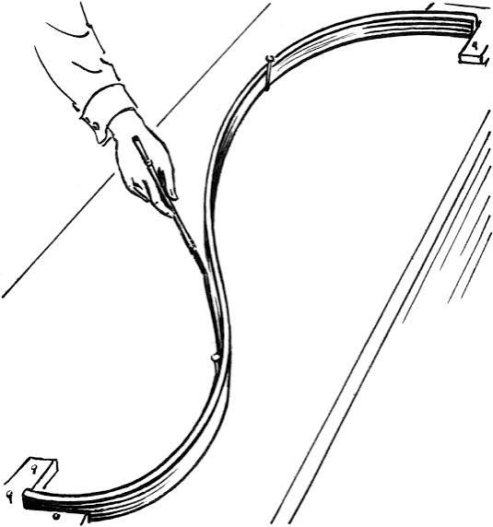
History of Splines
Long before splines were math, they were wood. To draw the sweeping curves of a ship's hull, draftsmen worked in the shipyard's mould loft, using a spline, a thin, flexible strip of wood bent to pass through a set of fixed points. The strip was pinned down by heavy weights called "ducks," and between those points it relaxed into the smoothest curve on its own, because a bending strip naturally settles into the shape that stores the least bending energy. Mathematicians later formalized exactly that idea and kept the name: a spline is the curve that passes through the points while bending as little as possible.
Papp, Splines: how do they work, 2020; WIKI, Flat spline, 2025
Notes:
https://www.lancaster.ac.uk/stor-i-stu
https://en.wikipedia.org/wiki/Flat_splinedent-sites/tamas-papp/2020/02/10/splines/

Slide 36
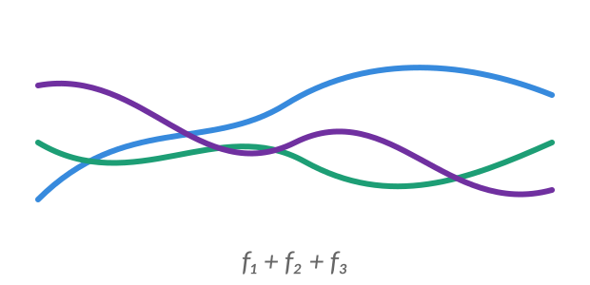
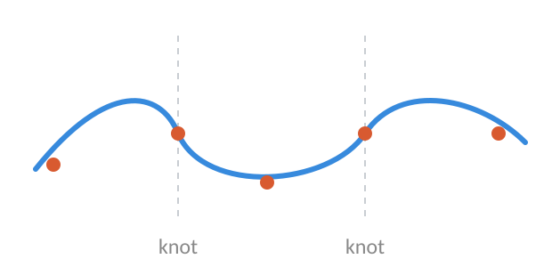
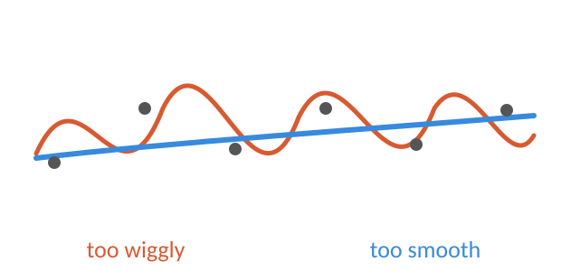
Putting It All Together
A GAM is only as good as the smooth curves inside it, and a curve flexible enough to be useful is flexible enough to go wrong (Hint: wiggliness vs overfitting).
1
2
3
→
→
A GAM is a sum of smooths
Each smooth is a spline
Flexibility cuts both ways
Each predictor gets its own flexible curve, not a straight line.
That flexibility comes from joining simple pieces, like the shipyard strip bending through its points.
Too wiggly overfits; too smooth misses the signal. A penalty (λ), fit automatically, finds the right balance.

Slide 37
Generated with Claude, for illustration purposes only.

Slide 38
Example Model Overview(s)
ARIMA — Statistical
GAM — Statistical
Models a series from its own past — autocorrelation, trend (via differencing), and seasonality.
Flexible regression using smooth spline terms to capture nonlinear trends and seasonality.
XGBoost — Machine learning
Gradient-boosted decision trees that learn from engineered features and lagged predictors.

Slide 39
XGBoost: Boosting Intuition
XGBoost builds its forecast from many small decision trees, added one at a time:
Start rough, then correct
Begin with a simple guess. Each new tree focuses on what the model still gets wrong (the residuals) and nudges the prediction closer to the truth.
Trees are the building blocks
A decision tree asks simple yes/no questions (e.g. “was last week high?”) and predicts a value for each group it creates.
Two dials keep it honest
Learning rate η sets how big each correction step is (small steps generalize better); regularization penalizes overly complex trees to prevent overfitting.
Each tree fixes the last one’s errors
Tree 1
Tree 2
Tree 3
Add trees step by step (Tree 1 + Tree 2 + …). The orange bars show the remaining error shrinking with each tree.
residual what the model still gets wrong · tree a simple yes/no prediction rule · η learning rate (step size) · regularization penalty that keeps trees simple

Slide 40
XGBoost for Forecasting
Trees need a table, so we turn the time series into features:
Turn history into features (X)
Recent lagged values, rolling averages, and calendar flags (week, month, holiday), plus outside signals like labs or wastewater.
Strengths
Learns nonlinear patterns and interactions on its own, handles many predictors, and is strong on tabular data.
Limits to watch
It cannot extrapolate a trend beyond values it has seen, needs enough history, and needs extra methods (e.g. quantile models) for prediction intervals.
In practice
A common, strong machine-learning entry in challenges like FluSight.
From a feature table to a forecast
lag
roll
week
y₋₁
ȳ
48
y₋₂
ȳ
49
Decision trees
ŷ (forecast)
X — table of predictors (features) · lag — a past value used as input · rolling average — a smoothed recent mean · ŷ — the forecast the model outputs

Slide 41
XGBoost
Extreme Gradient Boosting
Trees for tabular data: the secret sauce in machine learning

Slide 42
Outline
1
Machine learning algorithms and common use-cases
6
XGBoost workflow
2
Regression tree and CART
7
Core XGBoost terms
3
Tree ensembles
8
XGBoost classification intuition
4
Learning trees: advantages and challenges
9
XGBoost regression intuition
5
XGBoost overview
10
XGBoost advantages and disadvantages

Slide 43









Machine Learning Algorithms and Common Use-cases
Linear Models
Common Use-cases of XGBoost
for Ads Clickthrough
Anomaly detection
Factorization Models
for Recommendation
Ads clickthrough
Fraud detection
Deep Neural Nets
for Images, Audio etc.
Insurance risk estimation
Trees for tabular data
...
the secret sauce in machine learning

Slide 44


Regression Tree and CART
Regression tree
CART
A regression tree is a decision tree that predicts a numeric score. It asks feature questions and sends each record to a final leaf.
CART means Classification and Regression Tree. It is the tree framework used for both class labels and numeric predictions.

Slide 45
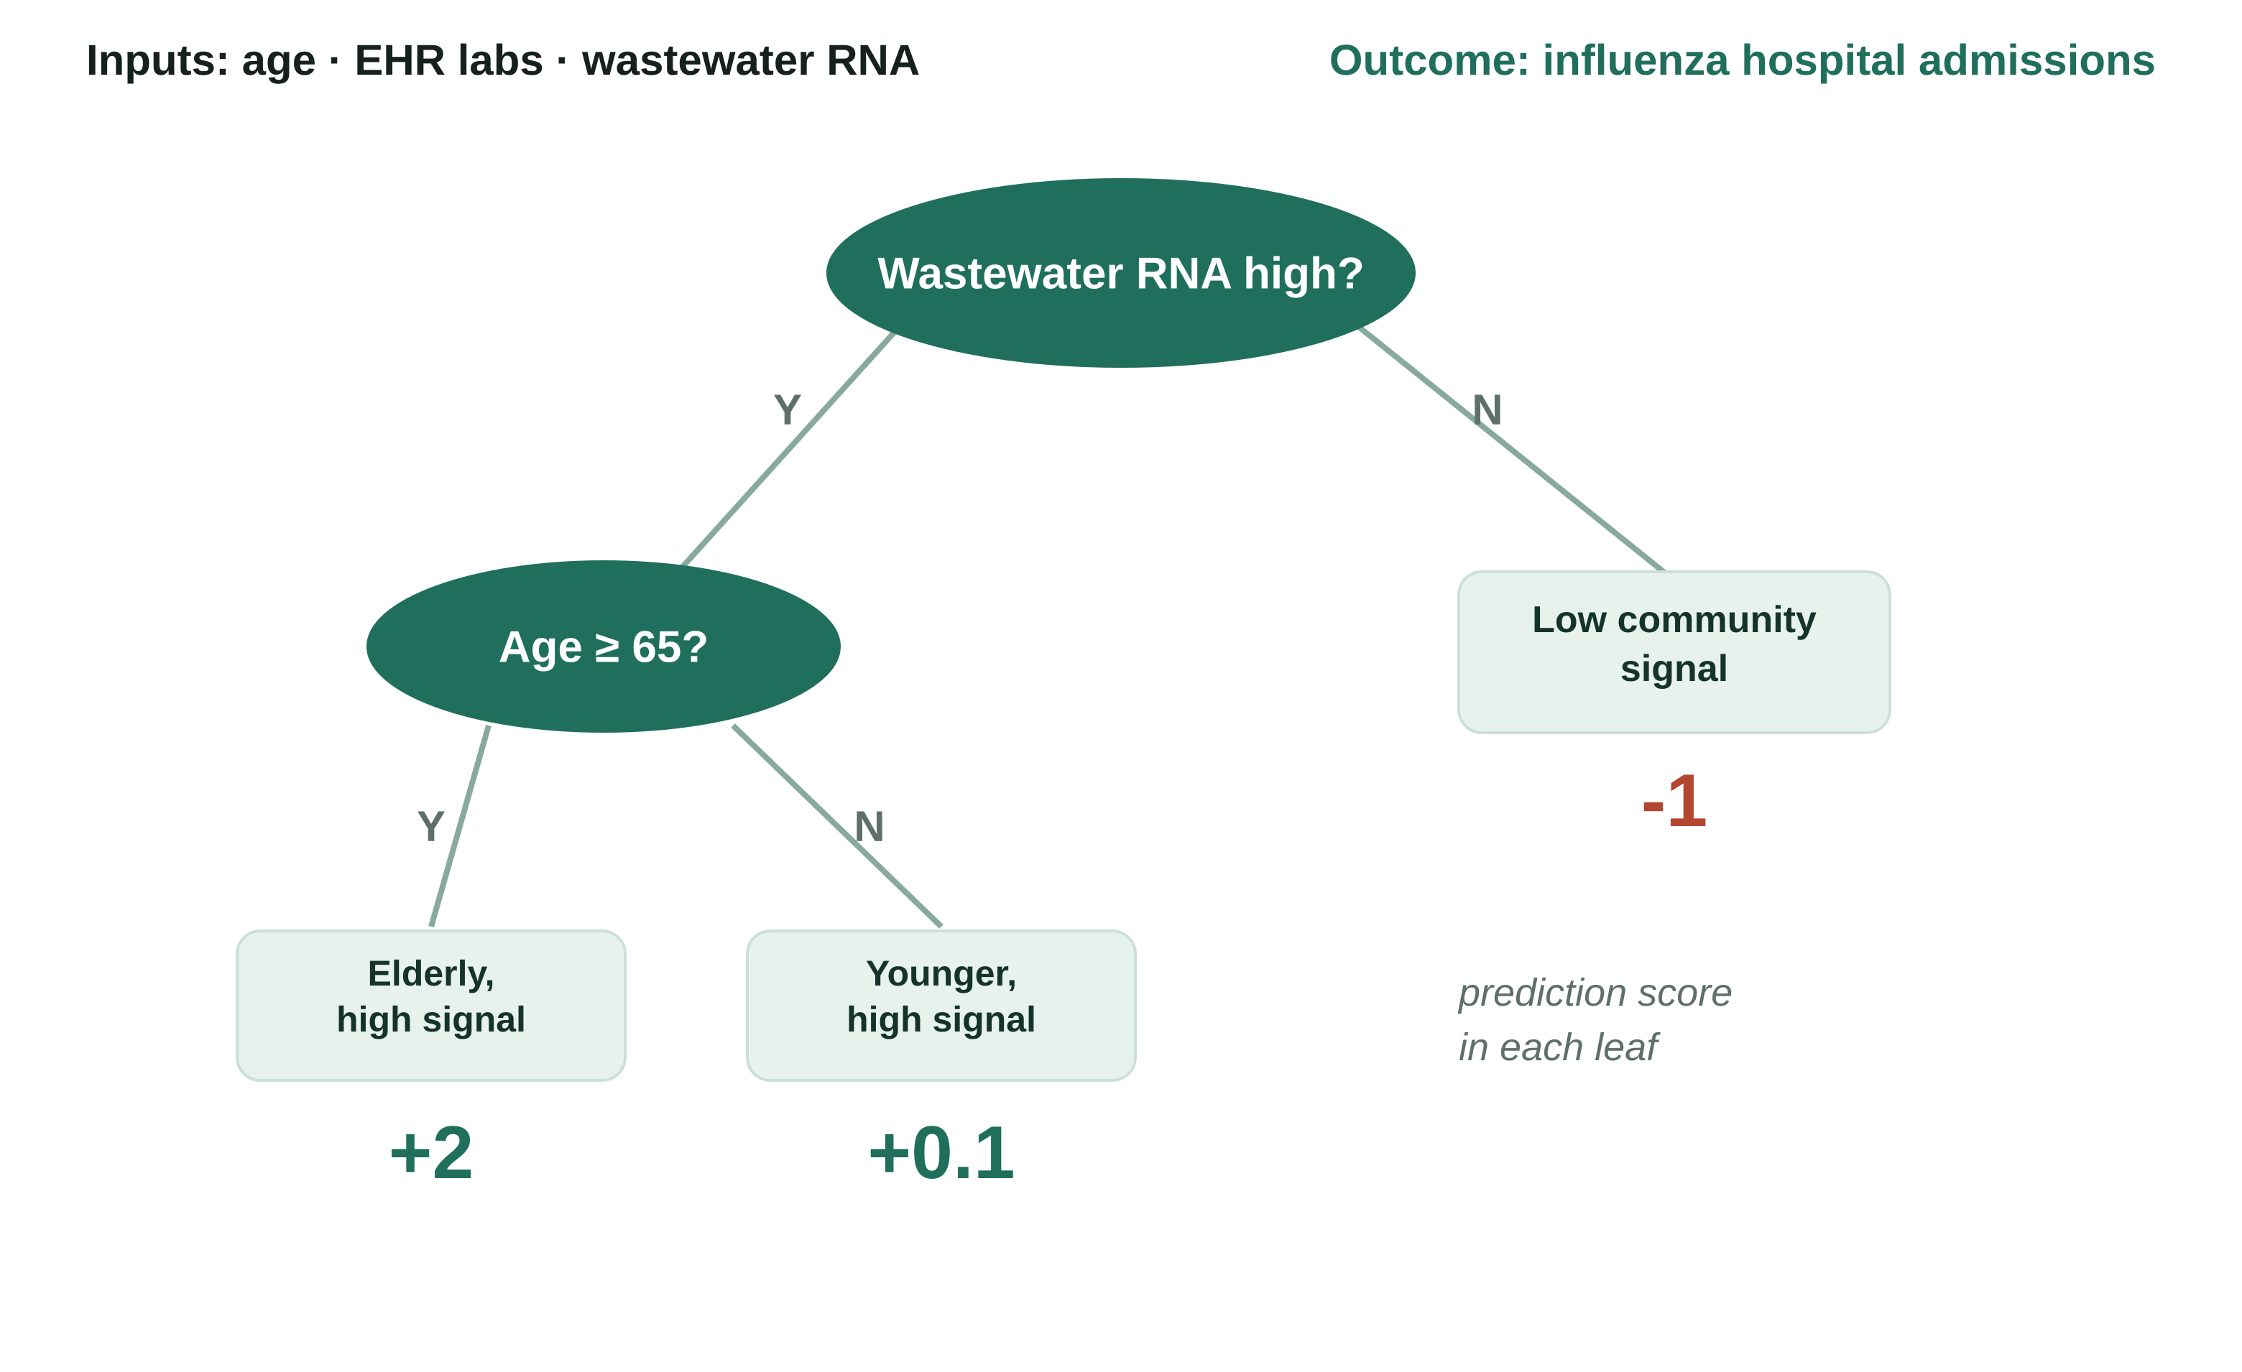

Regression Tree
Regression tree, also known as CART.
Ask a question, follow a branch, land on a score.

Slide 46
How the Regression Tree Reaches a Score
1
2
3
4
Problem
First split
Second split
Leaf score
The figure predicts influenza hospital admissions using features such as age, EHR labs, and wastewater RNA concentration.
The tree first asks whether the wastewater RNA concentration is high. This separates areas with heavy viral signal from areas with little signal.
Among high-signal cases, the tree asks whether age is 65 or older. This isolates the group most likely to be hospitalized.
Each final leaf gives a prediction score: +2 for high-signal elderly cases, +0.1 for high-signal younger cases, and -1 for low-signal cases.

Slide 47


Ensemble Trees
What are ensemble trees?
An ensemble combines multiple trees. Each tree gives a score, and the model combines those scores into one final prediction.
Why use an ensemble?
No single tree must be perfect. Different trees can specialize in different parts of the pattern.

Slide 48
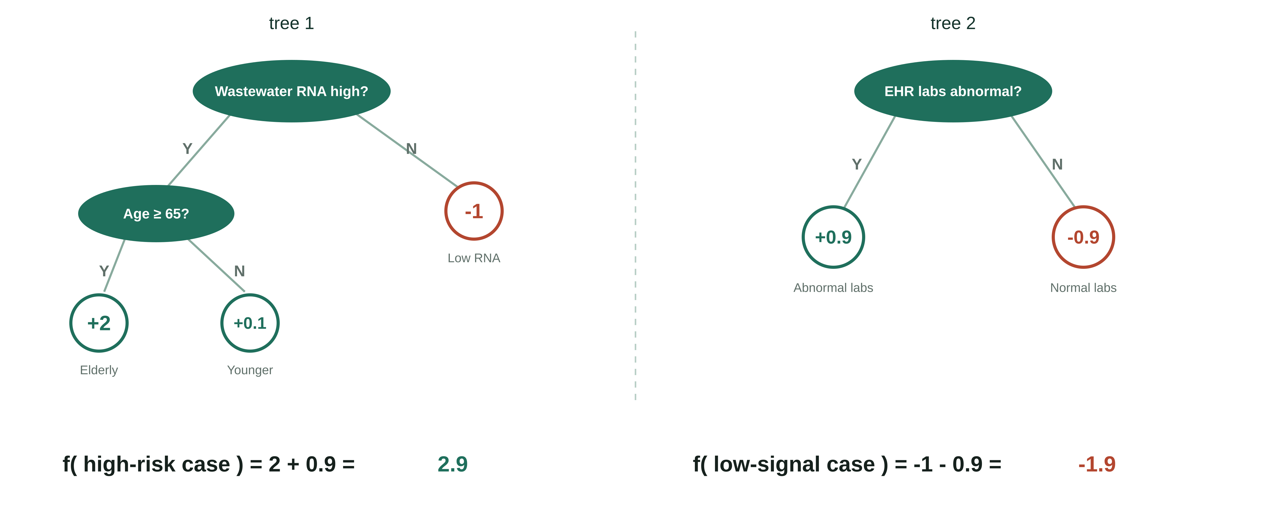
When Trees Form a Forest (Tree Ensembles)

Slide 49
How a Forest reaches a score
1
2
3
4
Problem
Tree 1
Tree 2
Final score
The model is still predicting influenza hospital admissions for each case.
The first tree uses wastewater RNA and age. For example, a high-signal elderly case receives a strong positive score.
The second tree uses EHR lab results. Abnormal labs add a positive score, while normal labs subtract score.
The ensemble adds the tree scores. In the figure, the high-risk case gets 2 + 0.9 = 2.9, while the low-signal case gets -1 - 0.9 = -1.9.

Slide 50


Learning Trees: Advantages
Highly accurate for many tabular data problems.
Easy to use because input scaling is usually not required.
Easy to interpret and control compared with many complex models.

Slide 51



Learning Trees: Challenges
Control over-fitting.
Improve training speed.
Scale up to larger datasets.
These three problems are exactly what XGBoost was built to solve.

Slide 52



XGBoost
Traditional models like decision trees and random forests are easy to interpret but may lack accuracy on complex data.
XGBoost (eXtreme Gradient Boosting) is an optimized gradient boosting algorithm that combines multiple weak models into a stronger, high-performance model.
It uses decision trees as base learners, building them sequentially so each tree corrects errors from the previous one and it is known as boosting.
It features parallel processing for faster training on large datasets and allows parameter customization to optimize performance for specific problems.

Slide 53
How XGBoost Works
Instance
Random Subset
Random Subset
Random Subset
Tree 1
Tree 2
Tree n
Result 1
Result 2
Result n
Weighting
Final Result

Slide 54
How XGBoost Weighs Its Trees
1
Instance
The top box is one case that needs a prediction, such as one patient whose influenza admission risk must be estimated.
2
Random subset
Each tree is trained from a subset of information, so different trees can learn different signals.
3
Trees
Tree 1, Tree 2, and Tree n each return a result for the same case.
4
Weighting
The separate tree results are weighted so stronger, or more useful tree outputs influence the final answer more.
5
Final result
The weighted results become one final prediction, such as the predicted influenza hospital admissions.

Slide 55
Core XGBoost Terms: Errors and Starting Point
Residuals
Initial guess
Loss function
Current prediction error for each row.
The starting prediction before any trees are added.
A score that measures how wrong the prediction is.

Slide 56
Core XGBoost Terms: Tree Parts
Root
Split
Branch
The first node where the tree starts.
A rule that divides rows into two groups.
The path from one tree node to another.
Leaf
Left leaf
Right leaf
A final node that stores a prediction output.
The terminal group reached from the left side of a split.
The terminal group reached from the right side of a split.

Slide 57

Core XGBoost Terms: Training Controls
Gain
Depth
Pruning
Gamma
Learning rate
The improvement produced by a split.
The number of decision levels in the tree.
Removing branches that do not help enough.
The minimum gain needed to keep a branch.
Controls how strongly each tree changes the model.

Slide 58
XGBoost Classification: Intuition (1)
▲ Let’s follow the algorithm:
1
Calculate the residuals based on initial guess of 0.5
2
Make the first split (average of last two observations) and calculate
Similarity score = (Σ Residuals)² / (Σ[Previous probability × (1 – Previous probability)] + λ) of each leaf
3
Calculate Gain = Left_similarity + Right_similarity – Root_similarity
4
Continue splitting with highest gain split. Default depth is 6 levels

Slide 59
XGBoost Classification: Intuition (2)
5
Prune the trees by calculating Gain - γ (3 by default). If negative, we prune the branch
6
Calculate Output =
Σ Residuals / (Σ[Previous probability × (1 – Previous probability)] + λ)
7
Find Predicted values = log odds of default + Learning rate (0.3 by default) × Output
8
Go to step 1: calculate new residuals from the new predicted values
Different Loss function
L(y, p) = – [y log(p) + (1 – y) log(1 – p)]

Slide 60
XGBoost Regression: Intuition (1)
▲ Let’s follow the algorithm:
1
Calculate the residuals
2
Make the first split of residuals and calculate
Similarity score = (Σ Residuals)² / (Number of Residuals + λ)
3
Find Gain = Left_similarity + Right_similarity – Root_similarity. Leave the first split in a form which maximizes gain
4
Continue splitting. Default depth is 6 levels

Slide 61
XGBoost Regression: Intuition (2)
5
Prune the trees: if Gain - γ (3 by default) < 0, we prune
6
Calculate Output =
Σ Residuals / (Number of Residuals + λ)
7
Find Predicted values = Default (0.5 by default) + Learning rate × Output
8
Go to step 1: calculate new residuals from the new predicted values

Slide 62

Advantages
XGBoost includes several features and characteristics that make it useful in many scenarios:
Scalable for large datasets with millions of records.
Supports parallel processing and GPU acceleration.
Offers customizable parameters and regularization for fine-tuning.
Includes feature importance analysis for better insights.
Available across multiple programming languages and widely used by data scientists.

Slide 63

Disadvantages
XGBoost also has certain aspects that require caution or consideration:
Computationally intensive; may not be suitable for resource-limited systems.
Sensitive to noise and outliers; careful preprocessing required.
Can overfit, especially on small datasets or with too many trees.
Limited interpretability compared to simpler models, which can be a concern in fields like healthcare or finance.
Cannot extrapolate beyond the range of values seen in training — as a tree-based model, forecasts are bounded by observed data and cannot capture trends outside that range.

Slide 64
Example Model Overview(s)
ARIMA — Statistical
GAM — Statistical
Models a series from its own past — autocorrelation, trend (via differencing), and seasonality.
Flexible regression using smooth spline terms to capture nonlinear trends and seasonality.
XGBoost — Machine learning
Ensemble — Meta-model
Gradient-boosted decision trees that learn from engineered features and lagged predictors.
Combines several models’ forecasts (mean, median, or weighted) — usually the most robust.

Slide 65
Ensembles: Combining Models
Combine forecasts from several models into one prediction that's more robust than any single model on its own.
There are a multitude of ways to combine forecasts, including:
Average or median of the member forecasts.
Weighted combination: members weighted by past skill.
Stacking: a model learns the weights.
Why ensembles work well
Models make different mistakes, so their errors partly cancel.
No single model is best every season, so the ensemble hedges instead of betting on one.
The result is steadier across changing conditions, with better-calibrated intervals.

Slide 66
Generated with Claude, for illustration purposes only.

Slide 68
Strengths, Weaknesses, and When to Use Each Model
Model | Strengths | Weaknesses | Optimal Use Case
ARIMA | Simple, fast, strong for short-term trends and seasonality | Assumes linear patterns; struggles with sudden shifts or extra predictors | Short-term forecasts from a single clean time series
GAM | Flexible curves capture nonlinear trends; stays interpretable | Can overfit; needs careful smoothing choices | Nonlinear trends where you still want to explain the drivers
XGBoost | Handles many predictors and complex interactions; high accuracy | Needs more data; harder to interpret | Rich data with many features and nonlinear effects
Ensembles | Combine models to boost accuracy and stability | More complex to build and run; less transparent | When robust, reliable forecasts matter most

Slide 69
Incorporating Predictors
Predictors add external signal beyond the outcome’s own history.
Target history tells us “what has happened.”
Predictors tell us “what may be changing.”
Availability: predictors must be known at forecast time.
For example, signals that can lead hospitalizations:
Influenza RNA in wastewater may precede in-patient hospitalizations by ~2 weeks
Influenza testing / positive labs may precede in-patient hospitalizations by 2 days to 2 weeks

Slide 70
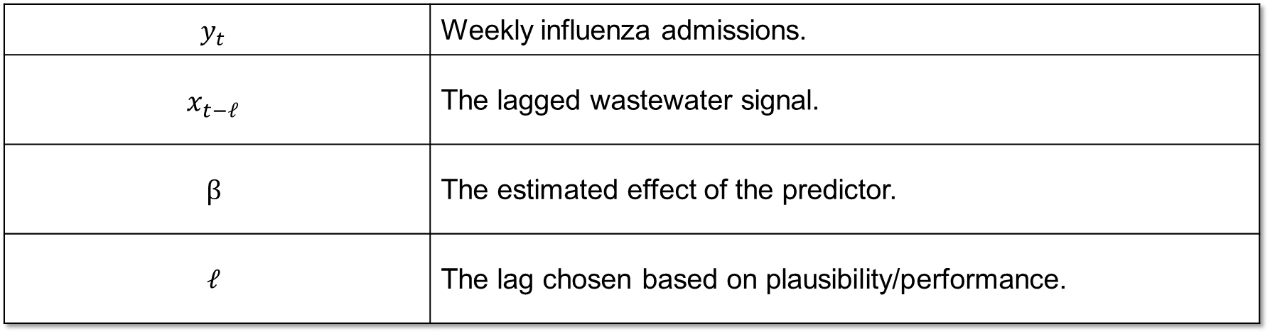
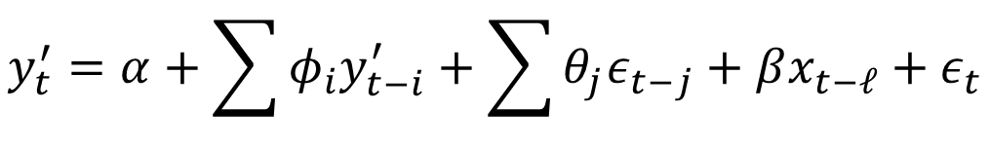
ARIMA: Incorporating Predictors
Formula:
$$y_{t}^{′}=α+\sum{φ_{i}y_{t−i}^{′}+\sum{θ_{j}ε_{t−j}+βx_{t−ℓ}+ε_{t}}}$$
$$y_{t}$$ | Weekly influenza admissions.
$$x_{t−ℓ}$$ | The lagged wastewater signal.
$$β$$ | The estimated effect of the predictor.
$$ℓ$$ | The lag chosen based on plausibility/performance.
For example, $x_{t−l}$ may represent wastewater RNA concentration from 2 weeks ago $(l=2)$ or positive labs for influenza based on EHR records from one week ago $(l=1)$

Slide 71
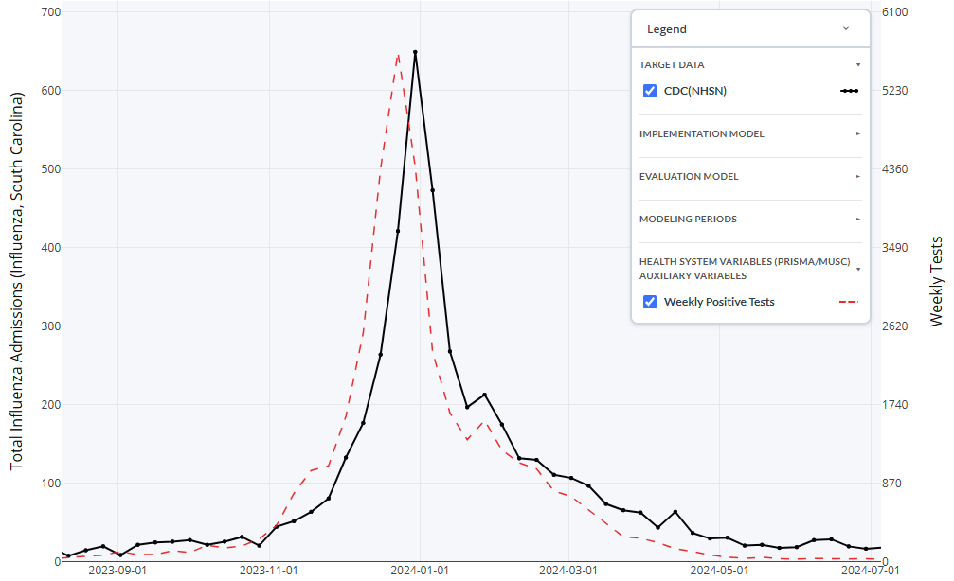
Positive Tests as a Leading Indicator (South Carolina)

Slide 72


Training and Testing Periods
Training
Testing
The past data the model learns from. It studies examples where the outcome is already known and adjusts to capture the patterns.
Fresh data the model has not seen. We use it to check how well the model really forecasts, by comparing its predictions to the real outcomes.
Like studying practice problems with the answer key.
Like sitting an exam with new questions.
OUR TRAINING PERIOD
OUR TESTING PERIOD
2020-08-08 → 2025-05-16
2025-10-04 → 2026-06-06
Rolling Window (grows one week at a time)
Rolling Window; Held out to score the forecasts

Slide 74
Overview: Model Evaluation
Once a model is fit, we measure how well its forecasts perform, judging both point accuracy and how well the model captures uncertainty.
Three metrics do this, one for the center of the forecast, one for its spread, and one for overall forecast skill:
Mean Absolute Error
95% PI Coverage
Weighted Interval Score
POINT ACCURACY
CALIBRATION
OVERALL SKILL
Average absolute gap between the median forecast and what actually happened. Lower is better.
How often the truth falls inside the 95% interval. Should land near 95%.
A single score across all quantiles that rewards forecasts that are both sharp and well-calibrated.
Point Accuracy
Overall Forecast Skill
In short: MAE checks accuracy, coverage checks the calibration, and WIS combines sharpness (interval width) and calibration into one score.

Slide 75
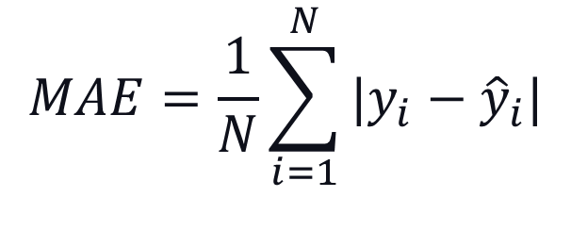
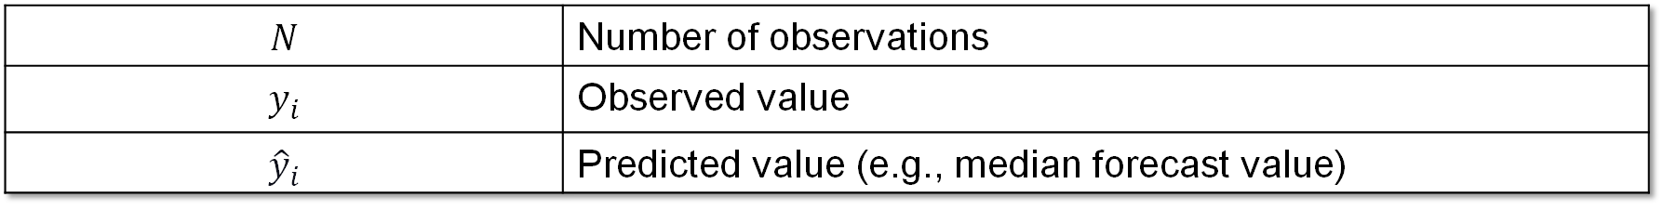
Mean Absolute Error (MAE)
Measure of how accurate point (single value per time point) forecasts are (i.e., how far the model's predictions fall from the observed case counts).
$$MAE=\frac{1}{N}\sum_{i=1}^{N}{|y_{i}−{\hat{y}}_{i}|}$$
$$N$$ | Number of observations
$$y_{i}$$ | Observed value
$${\hat{y}}_{i}$$ | Predicted value (e.g., median forecast value)
Ideal Value: Lower is better!

Slide 76
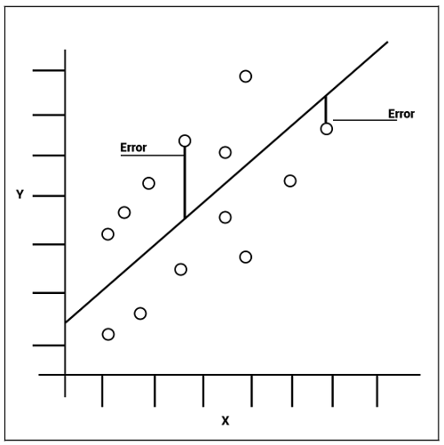

Slide 77
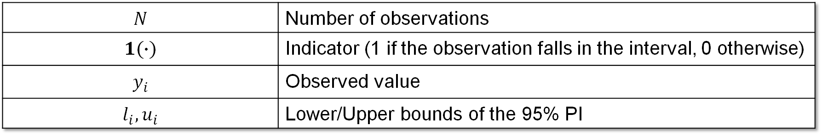
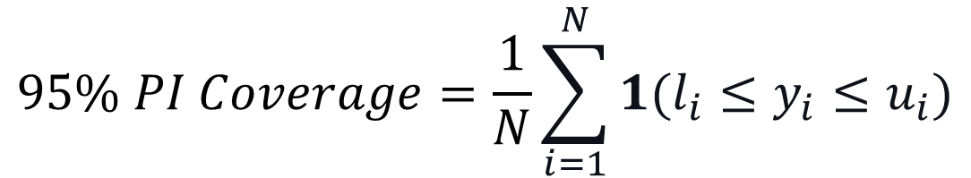
95% Prediction Interval (PI) Coverage
Measures how often the observed value is captured within the bounds of the 95% prediction interval (i.e., measure of how well the model captures uncertainty).
$$95\% PI Coverage=\frac{1}{N}\sum_{i=1}^{N}{1(l_{i}≤y_{i}≤u_{i})}$$
$$N$$ | Number of observations
$$1(∙)$$ | Indicator (1 if the observation falls in the interval, 0 otherwise)
$$y_{i}$$ | Observed value
$$l_{i}, u_{i}$$ | Lower/Upper bounds of the 95% PI
Ideal Value: ~95%; Below 95% = intervals too narrow (overconfident); above 95% = too wide (underconfident).

Slide 78
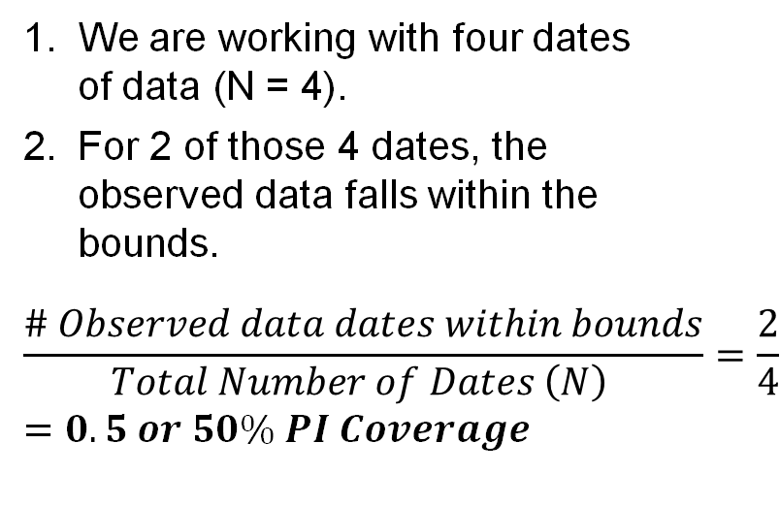
Legend
 | Observed Data
 | Forecasted Median
 | 95% PI Bounds
Calculating the 95% PI Coverage
We are working with four dates of data (N = 4).
For 2 of those 4 dates, the observed data falls within the bounds.
$$\frac{\# Observed data dates within bounds}{Total Number of Dates \left(N\right) }=\frac{2}{4}=0.5 or 50\% PI Coverage$$
Total Influenza Admissions
Weeks

Slide 79
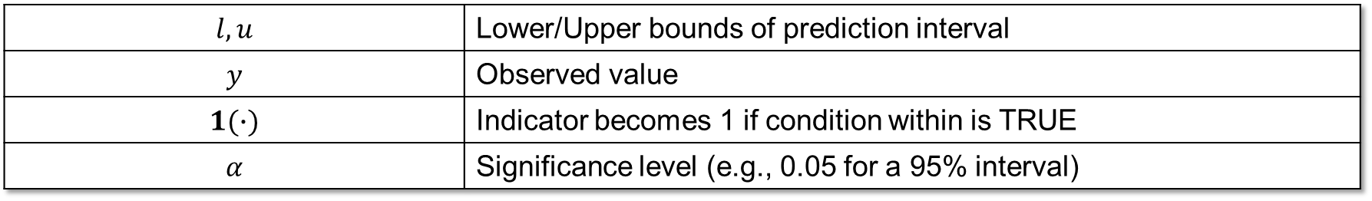
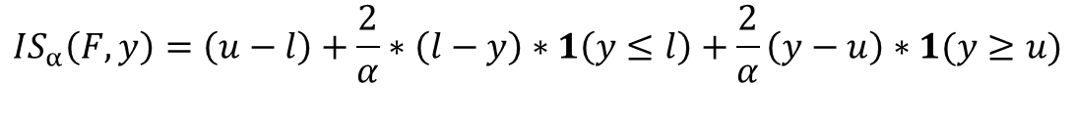
Interval Score (IS)
Measures how well a single prediction interval performs, rewarding intervals that are narrow but penalizing ones that the observed value falls outside, in the units of the observed data.
Overprediction
$$IS_{α}\left(F,y\right)=\left(u−l\right)+\frac{2}{α}∗\left(l−y\right)∗1\left(y≤l\right)+\frac{2}{α}\left(y−u\right)∗1(y≥u)$$
Dispersion
Underprediction
$$l, u$$ | Lower/Upper bounds of prediction interval
$$y$$ | Observed value
$$1(∙)$$ | Indicator becomes 1 if condition within is TRUE
$$α$$ | Significance level (e.g., 0.05 for a 95% interval)
Ideal Value: Lower is better!

Slide 80
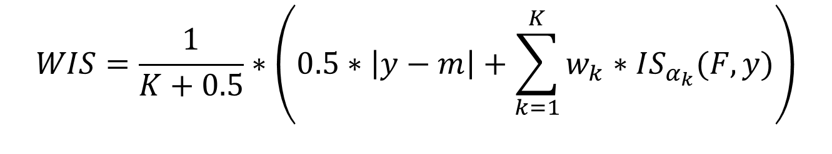
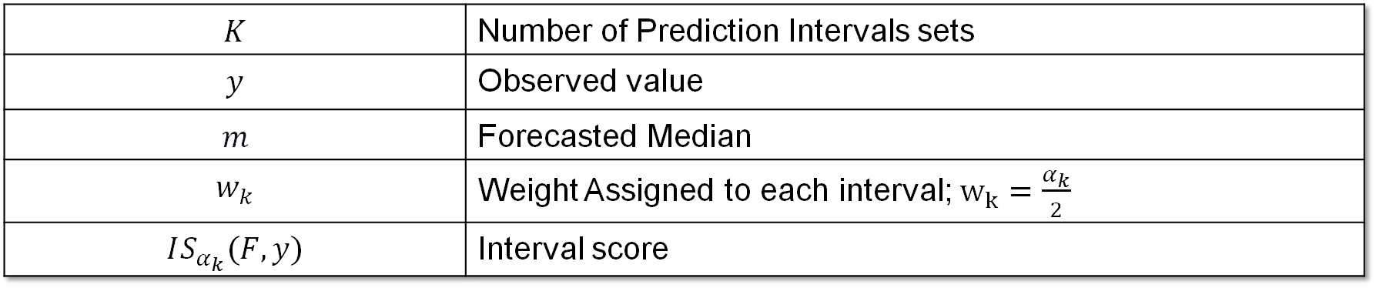
Weighted Interval Score (WIS)
Measures overall forecast quality, focusing on how close the whole predicted distribution is to the observed value, in the units of the observed data. It rewards forecasts that are both accurate and appropriately confident.
$$WIS=\frac{1}{K+0.5}∗\left(0.5∗\left|y−m\right|+\sum_{k=1}^{K}{w_{k}∗IS_{α_{k}}(F,y)}\right)$$
$$K$$ | Number of Prediction Intervals sets
$$y$$ | Observed value
$$m$$ | Forecasted Median
$$w_{k}$$ | Weight Assigned to each interval; $w_{k}=\frac{α_{k}}{2}$
$$IS_{α_{k}}(F,y)$$ | Interval score
Ideal Value: Lower is better!

Slide 81
Model Refinement: An Iterative Loop
In infectious disease forecasting, refinement means improving the forecasting system based on what we learn from evaluation.
Diagnose — Where does performance break down? By horizon, season phase, geography, outcome, or uncertainty.
Modify — Make a targeted change to the data, predictors, model structure, or uncertainty estimates.
Refit — Train the revised model using the same forecasting setup.
Re-evaluate — Compare forecasts against held-out observations.
Decide — Keep the refinement only if it improves out-of-sample forecast performance (i.e., in testing period).
Example: if flu hospitalization forecasts become less reliable at longer horizons, we may test whether adding wastewater improves 2– or 3-week-ahead forecasts.
Diagnose
Decide
Modify
Refinement
Loop
Re-evaluate
Refit
Note: refinement should improve future forecasts, not just make the model fit past data better.

Slide 82
Model Refinement: What Can We Refine?
Data & observation process — reporting delays, missingness, revisions, outliers, transformations, nowcasting.
Predictors & features — lagged outcomes, tests/labs, wastewater, digital traces, mobility, vaccination, weather, calendar terms, rolling averages.
Predictor transformations and interactions can also be explored (e.g., slope of past 3 lagged outcomes, log(wastewater), wastewater*septic tank use interaction)
Model structure — seasonality, lag structure, nonlinear terms, model class, hyperparameters.
Training strategy — rolling vs. expanding windows, recency weighting, geographic pooling, season-specific training.
Uncertainty estimates — prediction intervals, quantile forecasts, residual assumptions, calibration, ensemble weighting.
Example (flu forecasting): add lagged wastewater trends, or move from ARIMA to XGBoost.
Key idea: each refinement should target a weakness found during evaluation.
Notes:
References.
1. https://arxiv.org/abs/2006.00073
2. https://journals.plos.org/ploscompbiol/article?id=10.1371%2Fjournal.pcbi.1008618

Slide 83
Model Refinement: General Strategy
Start with a baseline — a simple, reproducible model as the benchmark.
Identify the weakness — use evaluation metrics and plots to find where forecasts fail.
Change one major component — data, predictors, model form, training setup, or uncertainty method.
Compare fairly — same forecast dates, targets, horizons, and testing period.
Assess tradeoffs — a change may improve MAE but worsen PI coverage or help one horizon while hurting another.
Example: compare ARIMA, ARIMA + wastewater, and XGBoost on the same rolling test period using WIS, MAE, and 95% PI coverage.
Bottom line: the best refinement improves forecast reliability across multiple settings under realistic conditions (e.g., multiple training/testing windows across seasons).

Slide 84
Working Example CDC NHSN Hospital Respiratory Data

Slide 85
Overview
Every week during influenza season, public health and healthcare decision-makers need to anticipate what's coming:
How many people will be hospitalized next week, and in the weeks ahead?
When will the peak hit and how high will it be?
In this working example, you’ll walk through a national-level influenza hospitalization forecasting system using real CDC data to help answer these questions.
The hands-on lab will focus on a human-AI teaming approach to achieve the same (or similar results).

Slide 86
CDC (NHSN) Hospital Respiratory Data
The weekly surveillance dataset behind our national flu forecasting pipeline.
What it is
Weekly hospital respiratory data from CDC’s National Healthcare Safety Network (NHSN), aggregated to the national (USA) and state or territory level, going back to August 2020.
What it captures
New admissions, hospital occupancy, and bed capacity for the three main respiratory pathogens: COVID-19, influenza, and RSV.
Reporting cadence
Published weekly by MMWR week as a preliminary release that is later finalized, so the most recent weeks can still revise before they settle.
How we use it
We keep the Total Influenza Admissions metric for the USA jurisdiction and clean it into a tidy weekly series. That cleaned series is the starting point for the entire forecasting pipeline.
Source: CDC National Healthcare Safety Network (NHSN) · data.cdc.gov

Slide 87
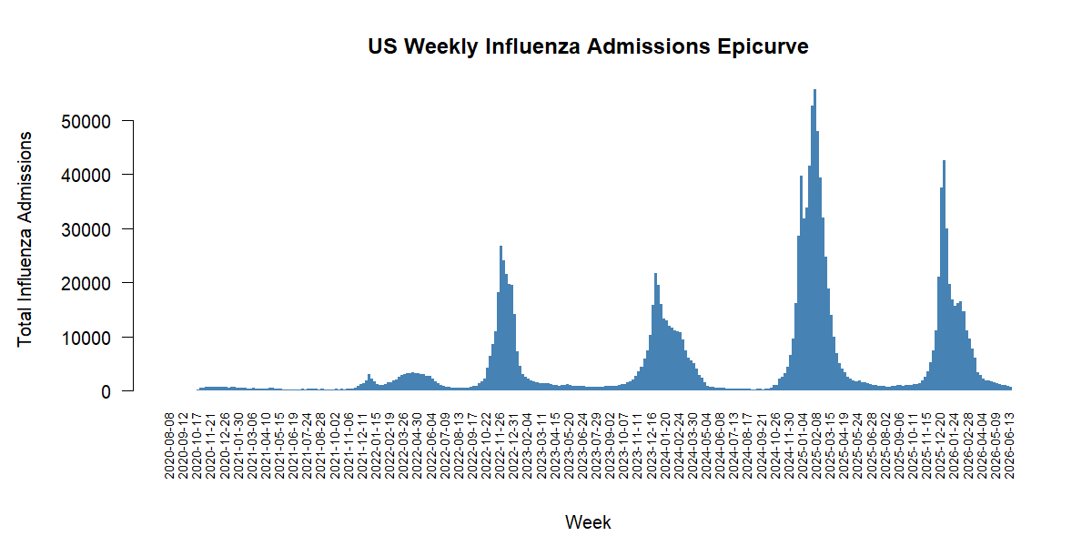

Slide 88
Exploring the Data
Before fitting a model and forecasting, we take a close look at the data to understand current and past trends, along with key epidemiological features such as peak timing and intensity.
We are retrospectively forecasting the 2025-2026 season, which raises a few questions:
How do we define a season?
How does this season compare to past seasons?
When did key turning points occur (peak timing), and how intense were they (peak intensity)?
Why this matters: Exploring the data, through both visuals and summary values, is how we build a full picture of what is going on before we commit to a model.

Slide 89
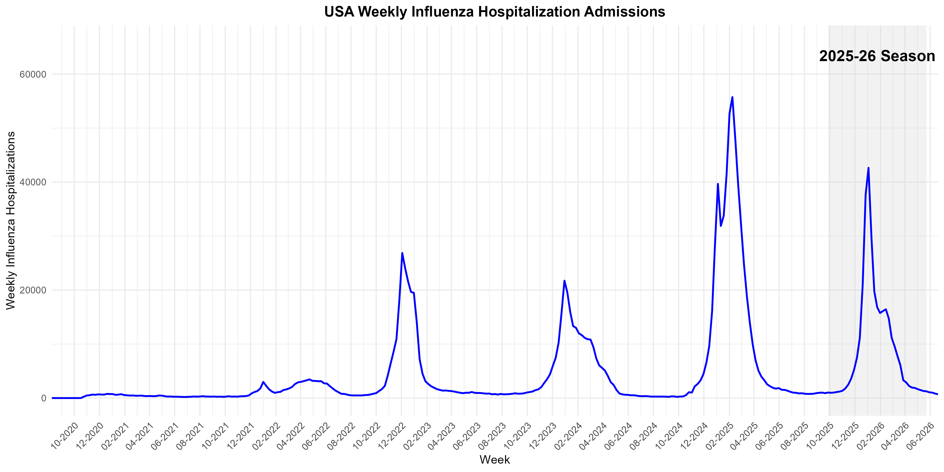
National Trend, Current Season Highlighted
2025-2026 Statistics
Season Start | 2025-09-28
Peak Time | 2026-01-03
Peak Intensity | 42,634
Decline Start | 2026-01-10
Season End | 2026-05-17

Slide 90
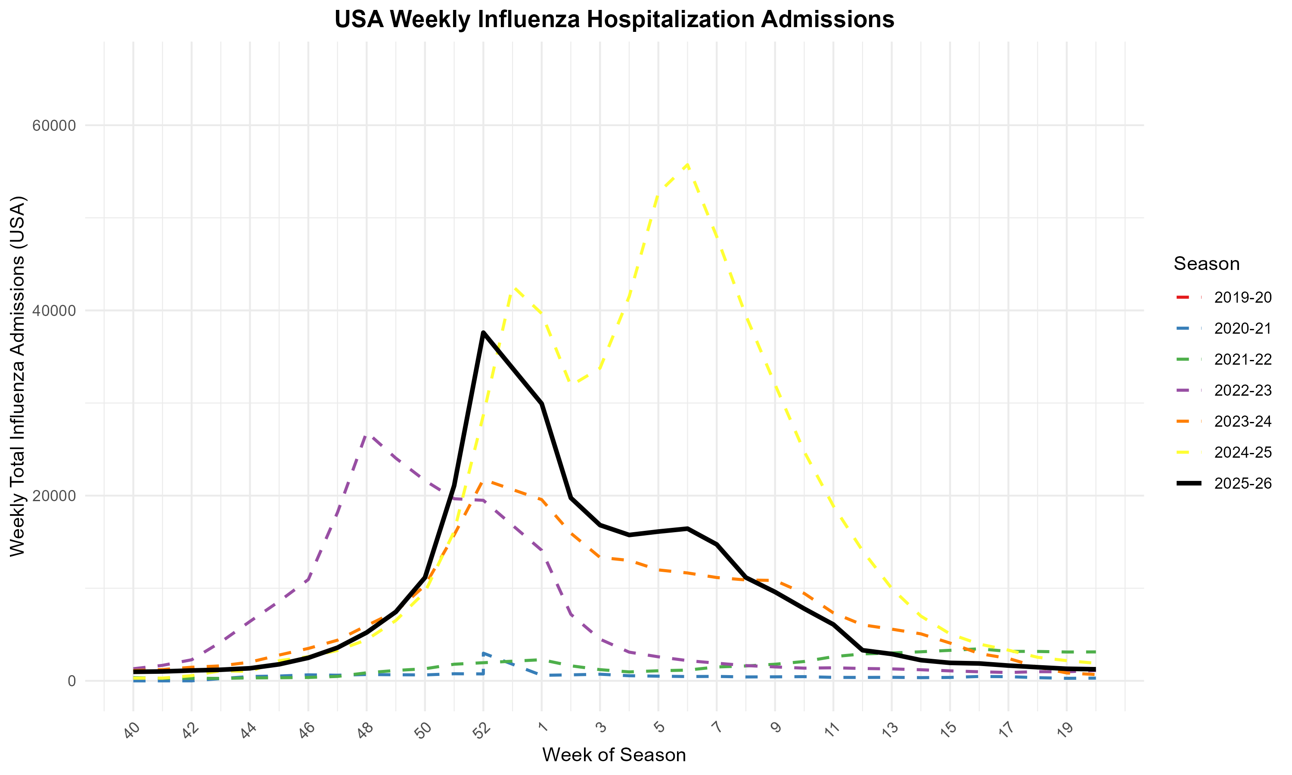
Current Season vs Past Seasons

Slide 91
First Pass: Model Building and Forecasting
Model | ARIMA
“Current Week” | Rolling Window (2025-09-27 through 2026-05-16)
Target Data | CDC NHSN Data
Auxiliary Data | None
Outcome | National Weekly Total Flu Admissions
Training Period (Rolling Window) | 2020-08-08 through 2026-05-16
Testing Period | 2025-10-04 through 2026-06-06
Horizons | 1, 2, & 3 Weeks

Slide 93
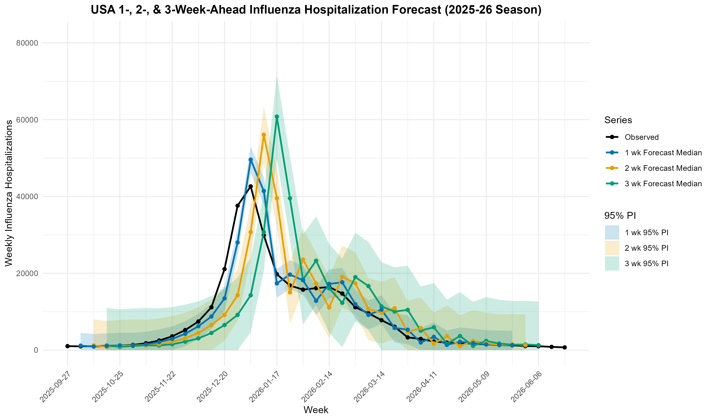

Slide 94
Forecast (Testing Period) Evaluation
Evaluation tells us how much we can trust a forecast. By comparing predictions against what actually happened, we can see which models are reliable and where they tend to go wrong.
The table below shows each metric averaged across all forecast periods (the separate windows of time we made forecasts for), so every number summarizes performance over many forecasts, not just one.
Testing period range: 2025-10-04 → 2026-06-06
Horizon | WIS (Range) | MAE (Range) | 95% PI Coverage
1 | 1529.8 (312.5 – 10129.1) | 1954.2 (16 – 11505) | 0.88
2 | 3493.9 (532.3 – 23364.3) | 4407.7 (34 – 26148) | 0.85
3 | 4862.8 (705.1 – 36917.7) | 6102.2 (99 – 41058) | 0.85

Slide 95
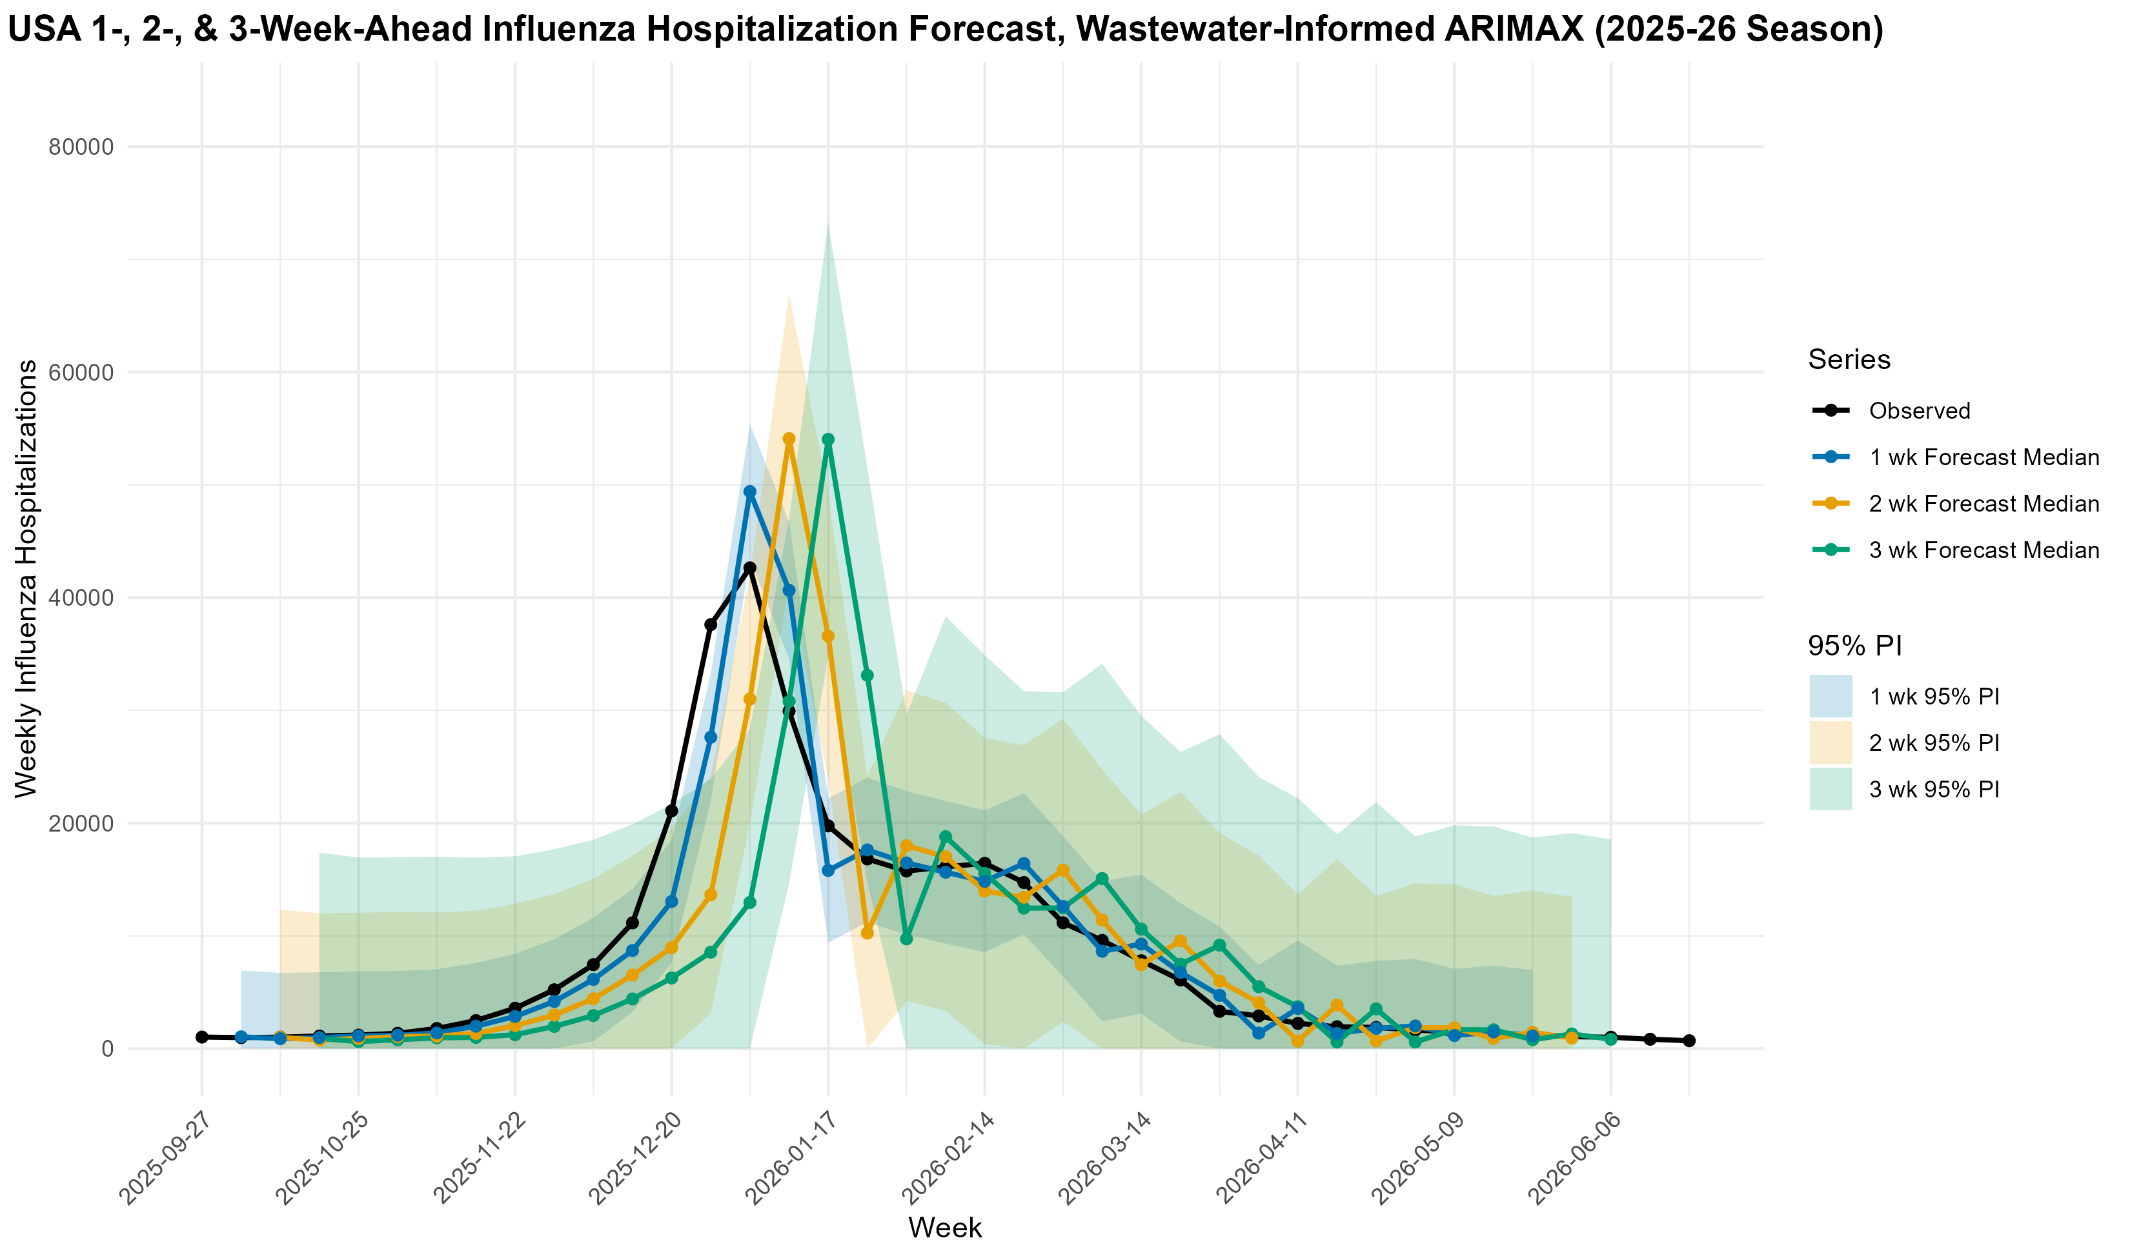
Refinement: Added Indicator

Slide 96
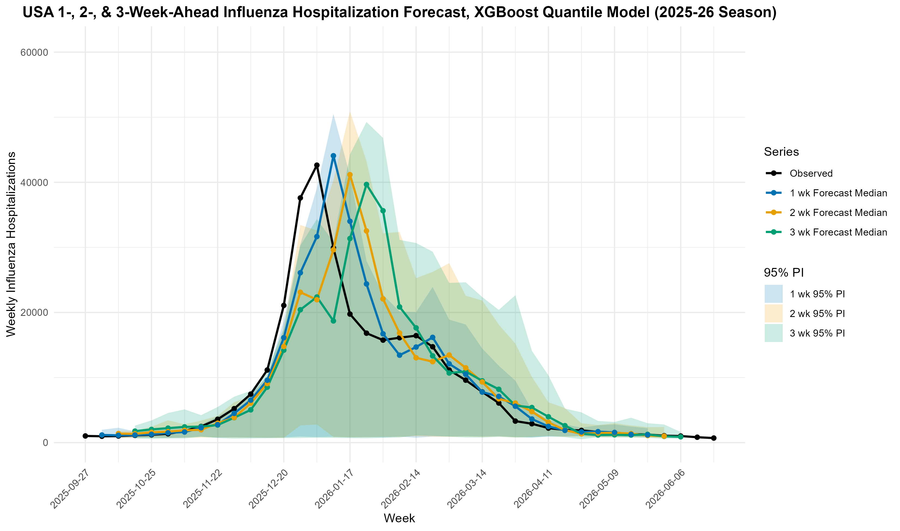
Refinement: Trying XGBoost

Slide 97
Evaluation Example: 3-week Forecast
Suppose our interest lies in the 3-week ahead forecasts
We measure each change against the current model using common evaluation metrics, then decide whether to keep it or revert.
Change | Model | Indicator | WIS | MAE | 95% PI Coverage | Keep?
Baseline | ARIMA | N/A | 4862.8 | 6102.2 | 85% | —
Leading Indicator | ARIMA | National WVAL | 4271.1 | 5407.0 | 91% | [ Y / N ]
Model Swap | XGBoost | N/A | 2634.8 | 4179 | 91% | [ Y / N ]
These evaluation metrics were averaged across all 3-week forecasts over the testing period. Are these sufficient? Are there other metrics we could have used?

